Slide 1
ARM Core Data Flow Model
Department of Computer Science and Engineering
Amrita School of Engineering
Coimbatore

Slide 2
Learning Outcome
At the end of this presentation you will be able to
Draw Data flow model of ARM core processor
2. Illustrate functional importance of elements in data flow model of ARM core processor

Slide 3
ARM Core Processor
RISC Architecture
Uses Load Store Architecture
Load instruction copy data from memory to registers
Store instruction copy data from registers to memory
No data processing instructions that directly manipulate data in memory - hence data processing is carried out in registers.

Slide 4
Elements of ARM Core Processor
Instruction Decoder
Register File
Sign Extend
Barrel Shifter
MAC
ALU
Address Register
Incrementer

Slide 5
What are different Processor Architectures

Slide 6
Processor Architectures
Based on the number of program and data buses used, there are three types of Processor Architectures
Von Neumann Architecture
Harvard Architecture
Super Harvard Architecture

Slide 7
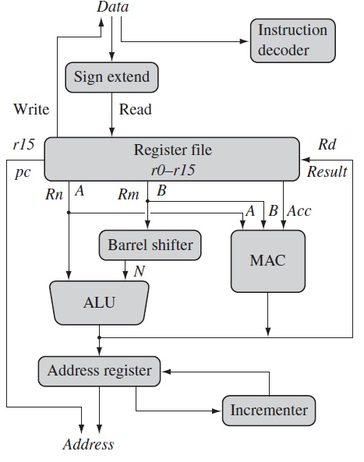
ARM Core Data Flow Model
ARM core data flow describes how an instruction is decoded inside the ARM core and how a particular instruction is executed by interacting with the internal registers file and then send result out of the registers.

Slide 8
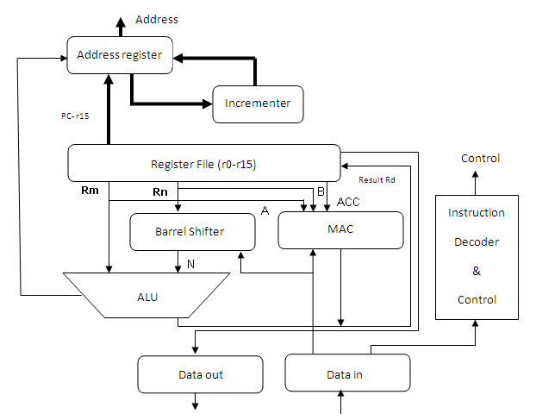
The arrows represent the direction of data flow, and the lines represent the buses and the boxes represent either a storage unit or an operation unit.

Slide 9
ARM falls in the RISC category which follows the Load and Store architecture.
Means, with Load and Store architecture in place, registers will be mandatory for processing to be carried out.
Without registers one cannot do any sort of operation with ARM core.
ARM has 2 source registers Rm and Rn and one destination register which carries the result. The destination register is named as Rd. ( Instructions typically use two source registers and single result/destination register. - Three address format )
A and B are the two buses that will help in reading the source operands.
Rm and Rn values will be fetched from the buses A and B and computation will be carried out in the ALU or MAC (Multiplication and Accumulate unit). Address registers are used to hold the address and address bus will facilitate the storage action.
Barrel shifter is a kind of support which is very useful in association with ALU for expression evaluation and address calculation.
After going through the steps and sequences the result will be moved to the Register Rd.

Slide 10
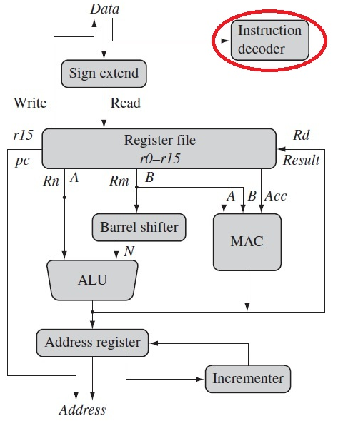
Instruction Decoder
It decodes the instruction before execution is carried out.
There are three kinds of instruction set supported in ARM core.
They can be ARM instruction set; Jazelle Instruction set and THUMB instruction set.
With the CPSR one can set the operation state and accordingly instruction set can be selected

Slide 11
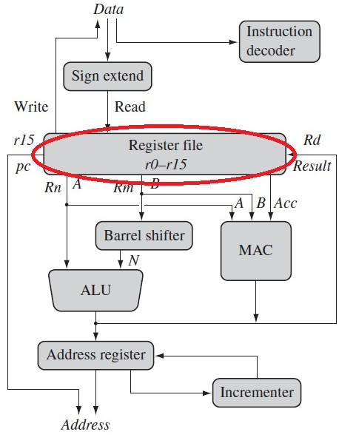
Register File
Data processing in Registers
Storage bank of 32 bit registers
16 registers
r0 to r15

Slide 12
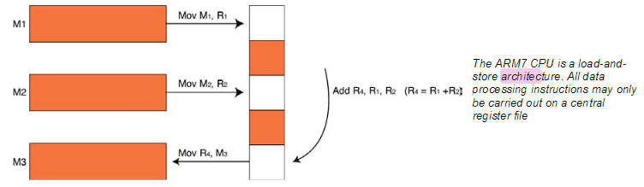
Programmers Model – Register Architecture
The ARM7 is a load-and-store architecture, so in order to perform any data processing instructions the data has first to be moved from the memory store into a central set of registers, the data processing instruction has to be executed and then the data is stored back into memory. (This is Load and Store, Recollect the past)

Slide 13
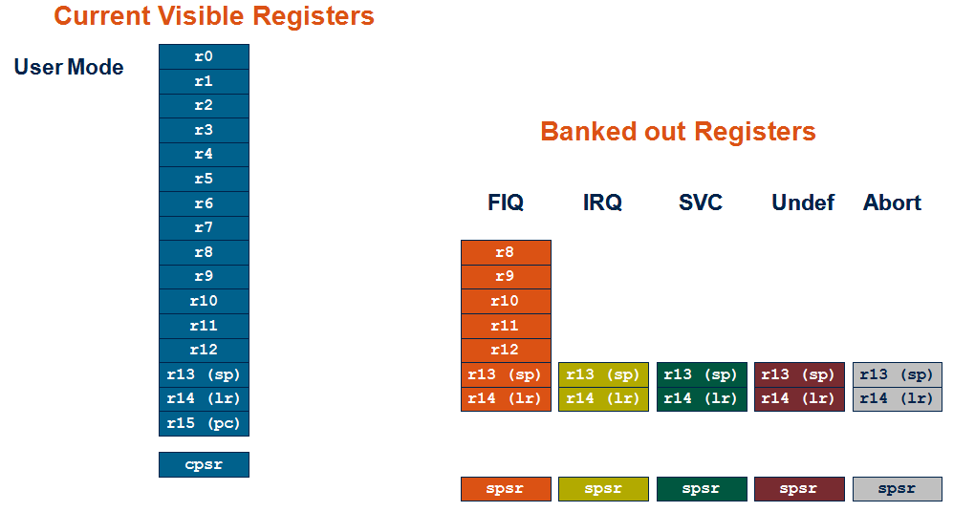
Register File

Slide 14
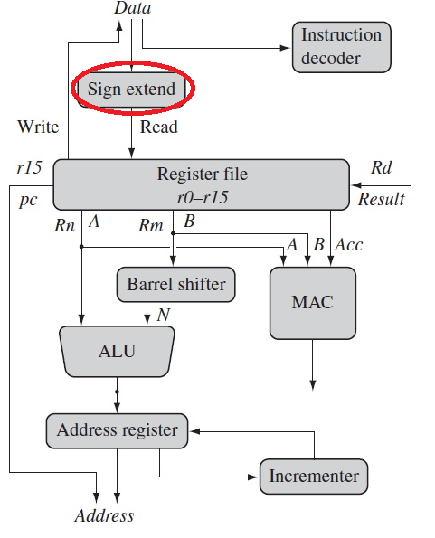
Sign Extend
Registers hold signed or unsigned 32 bit values
Sign extend hardware converts 8 bit and 16 bit numbers accessed from memory to 32 bit numbers to place in registers.

Slide 15
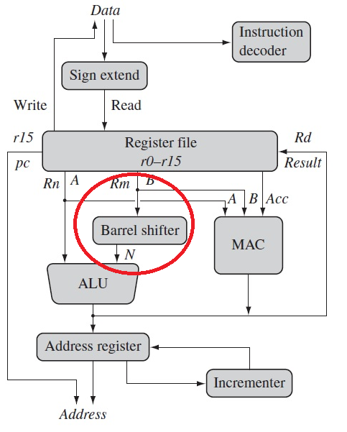
Barrel Shifter
Register Rm can be preprocessed in barrel shifter before it enters ALU
Barrel shifter and ALU can calculate a wide range of expressions and addresses
A barrel shifter is a digital circuit that can shift a data word by a specified number of bits without the use of any sequential logic, only pure combinatorial logic. ... A barrel shifter is often used to shift and rotate n-bits in modern microprocessors, typically within a single clock cycle.
http://www.davespace.co.uk/arm/introduction-to-arm/barrel-shifter.html

Slide 16
Barrel Shifter Contd….)
In classical shift register, the number of shifts requires an equivalent number of clocks because, the shifting takes place based on clocks.
In barrel shifter, Combinational circuit is used, where the shifting takes place in a single attempt itself.
In fact, the shift takes place in the same instruction itself. This is a very basic enhancement present in the ARM data path.

Slide 17
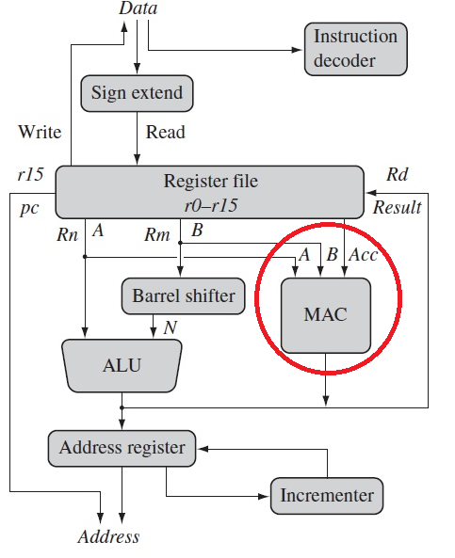
MAC - Multiply Accumulate Unit
Takes register values Rn and Rm from A and B buses and compute result
Data processing instruction will write result in Rd to register file

Slide 18
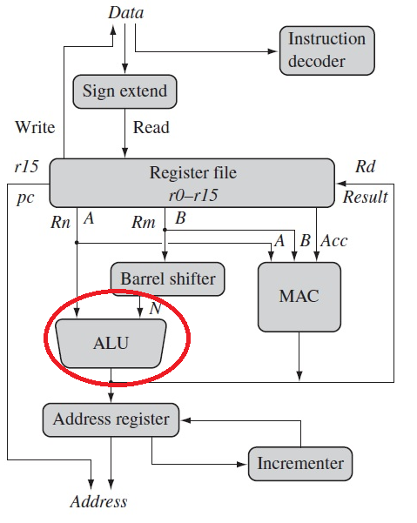
ALU – Arithmetic and Logic Unit
Load and store instruction use ALU to generate address to be held in address register
The address is broadcast on address bus

Slide 19
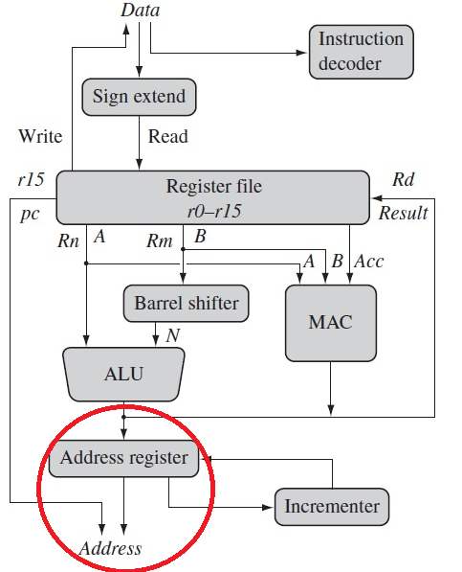
Address Register
The PC value is in the address register which is fed in to the incrementer, then the incremented value is copied back in to r15.
It is also written in to address register to be used as the address for the next instruction fetch.

Slide 20
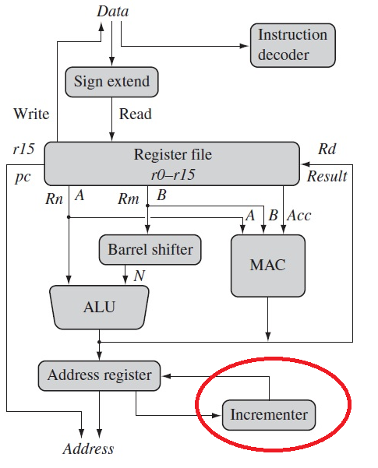
Incrementer
Updates the address register before it read or writes next register value from / to the next sequential location.
The other interesting feature is the increment and decrement logic which can operate on the registers that are independent of the ALU.
This facilitates the implementation of auto-increment and auto-decrement features in the ARM, where it is used for movement of blocks of data between the memory and registers.

Slide 21
Conclusion

Slide 22
Queries

